Slide 1
Physical Security

Slide 2
What is Physical Security?
Security for things that is not a piece of software
There are physical penetration testers for a reason. Some stuff they can do include phishing, lockpicking, etc.
You can have the best software defenses, but if someone leaves a terminal open, then… it’s game over.
Examples?

Slide 3


Physical Security Examples
Humans
Computer
Doors
Leaving an unlocked computer
Ol’ reliable USB

Slide 4

Locks & Lock Picking
You know… the thing in Skyrim
Alternative bypass tools, and methods are commonly used
Lockpicking is a method of last resort
It may not be practical in all scenarios
Crowded Area
High Visibility
Time sensitive
Disclaimer Don’t do this on items you do not own or have consent to use and also do not do this on important locks! You may break them!
Notes:
I assume you all have seen lockpicking portrayed in some movie, video, and likely some game you have played in the past. I can assure you based on my experience of “NONE” that the media we watch makes it seem much easier, and more predictable then it is in reality.
Oftentimes when someone wants to open a secured entryway, lockpicking is not their first choice. Oftentimes the use some kind of bypass, this could be something they stick in the cracks of the doors to manipulate the door bar, or handle.
They could use more creative methods like a compressed air can to trigger a sensor that unlocks the door (Fire escapes), they would in the case of doors with RFID controls scan someone’s ID to make a copy.
A more direct method suchs as shown in the image may be applied, but to do it more… discreetly they may in cases where the hinges are visible remove the hinges or the pin holding the door to the hinges.
If you need to do something quickly, or secretly in a semi-public area, it can be quite awkward.
Opening a locked door into an office filled with people is semi-recoverable with lockpicks
Taking the door off the wall is not.

Slide 5

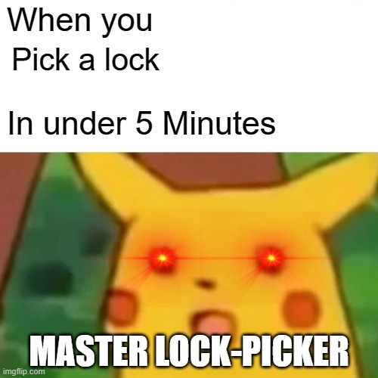
Why You Can Pick A Lock
Perfection is a fiction, unless your lock is thousands of dollars.
We therefore need to exploit the locks construction!
Pick up the pins, simple as that
We push the key pins to manipulate the driver pins
Notes:
This all boils down to the tolerances, and mistakes allowed during the manufacturing of a lock
Some Good things: The holes drilled that hold the pins will not be aligned. This allows us to both find the pin currently blocking the mechanism from turning, and set the blocking pins on by one till we have set all of the pins
The lower the quality, the lower the tolerance of the lock, that is we will have an easier time finding the binding pin, and an easier time setting the pins.
This includes:
The Pins themselves, they may have gashes and chips which may give false feedback

Slide 6
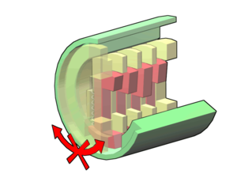
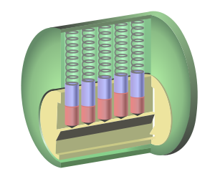
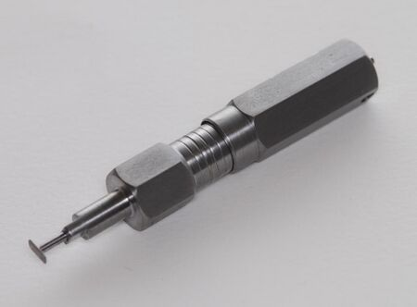
Types of Locks
Different types are… Different, each presents their own challenge and methods of exploitation.
Wafer Lock - Push wafers (Square cutouts) into position.
Pin Tumbler Lock - One of the most common in North America, there are many variations of this lock
Disk Detainer - Not so common, vulnerable to the same attacks a pin tumbers
Notes:
Wafer locks are common in office environments, being so cheap we can often use a simple jiggle key, or rake to open them as they often have very low tolerances, that is they have greater margins for error, and are easier to pick open due to that fact.
Pin tumbler locks are those most commonly found in the US, and portrayed in most media that covers lock picking.
The most important part of the lock are the key pins those red pins shown in the middle image, and the driver pins those portrayed as blue in the middle image
We push up the red key pins till the blue pin goes over the sheer line, and the lock is free to rotate
The tolerances vary with Pin tumbler locks, and they often use implement security pins to make picking these harder.
I will not say much about disk detainer locks, other then they are similarly vulnerable to attacks, however they require specialized tools (which I do not own) to pick. This gives them more of a mystique, and better reputation that is not totally true.

Slide 7
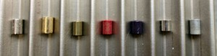

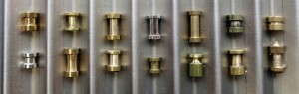
Defenses
Nothing is safe, just more challenging
Notes:
The only defense against lockpicking is to not have a lock.
This is like “Hyppönen Law about IoT security, which states that whenever an appliance is described as being "smart", it is vulnerable.”
If there is a lock, there is either a method to pick the lock, or bypass it. The question we are more concerned with is feasibility, and difficulty.
Lock designers often implement security pins both for the key and driver pins to provide false feedback to the lock picker, making it more difficult to exploit the system. There is quite the variety of them and I would suggest looking at the locklab’s document on them, and how you can detect and bypass them.
They may also design the keyway to make accessing the pins difficult!
https://locklab.com/anti-picking-designs-bosnianbills-locklab/

Slide 8
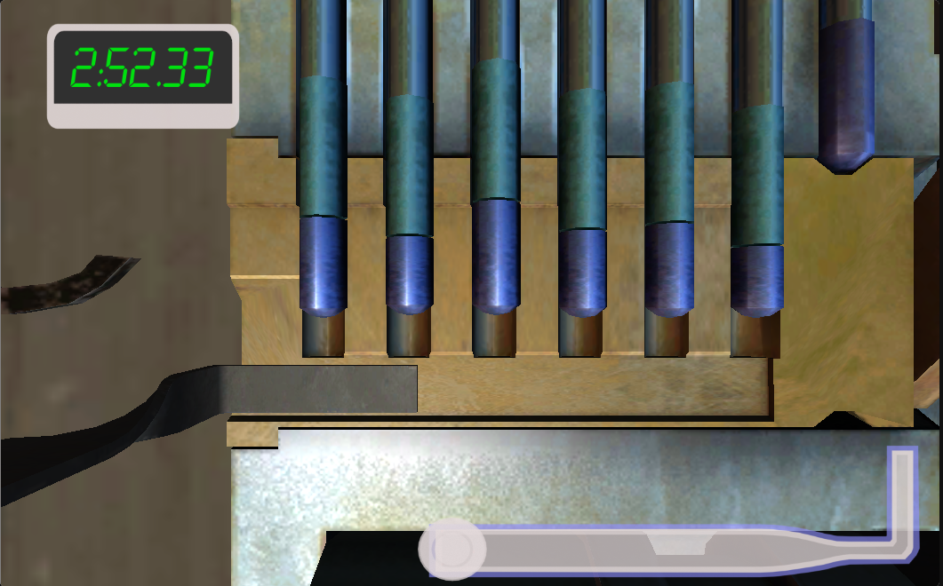
Website Simulator
https://simmer.io/@Xill/lockpick-simulator
Q, E, WASD. Tension slider on the bottom.
Doesn’t work in firefox
Notes:
Bernal This is all you

Slide 9
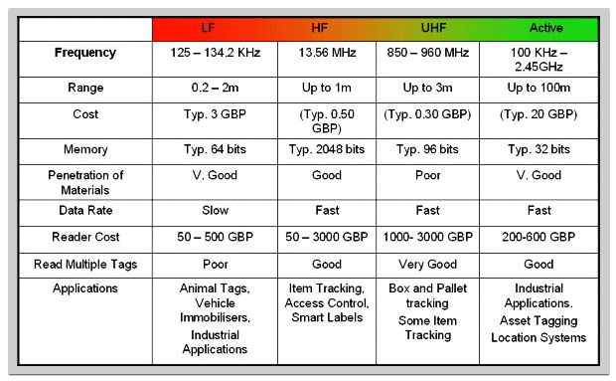
RFID

Slide 10
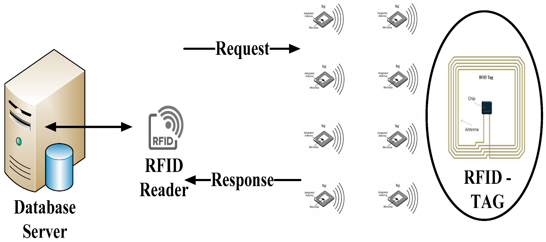
Challenge-Response

Slide 11
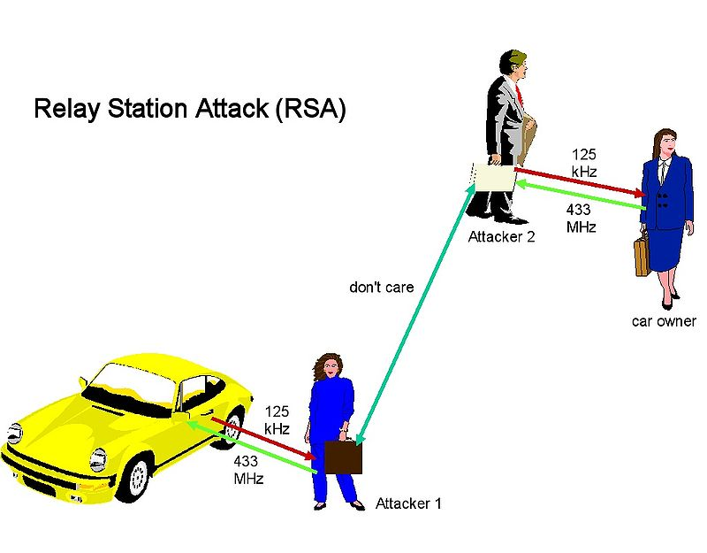
Replay Attack

Slide 12
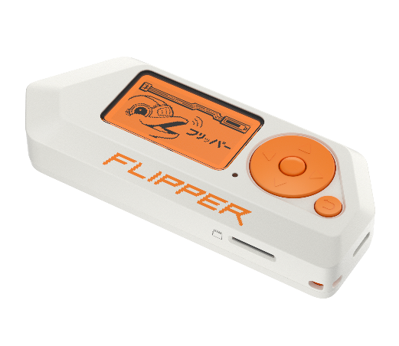
Flipper Zero

Slide 13
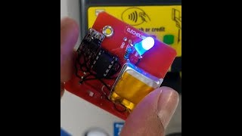
Video

Slide 14
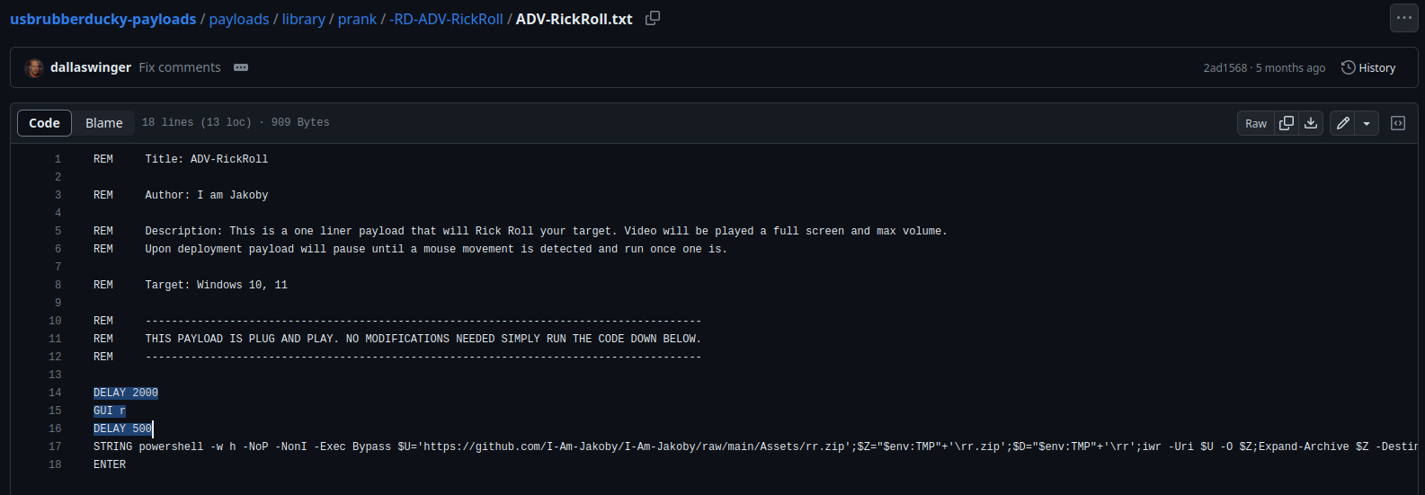
Ducky Script

Slide 15
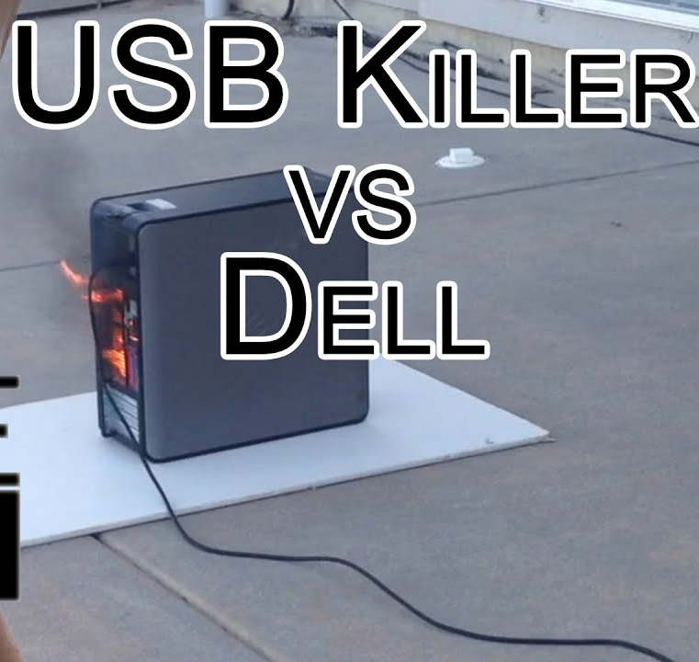
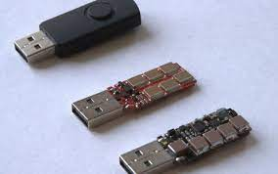
USB Killer

Slide 16
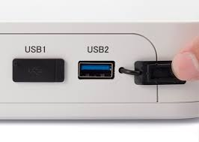
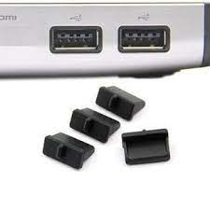
USB Port Covers

Slide 17
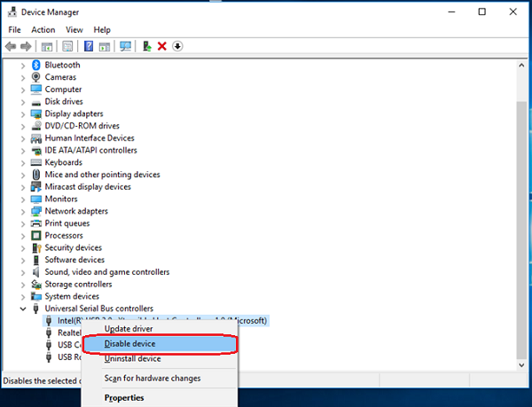
Disabling USB Ports

Slide 18
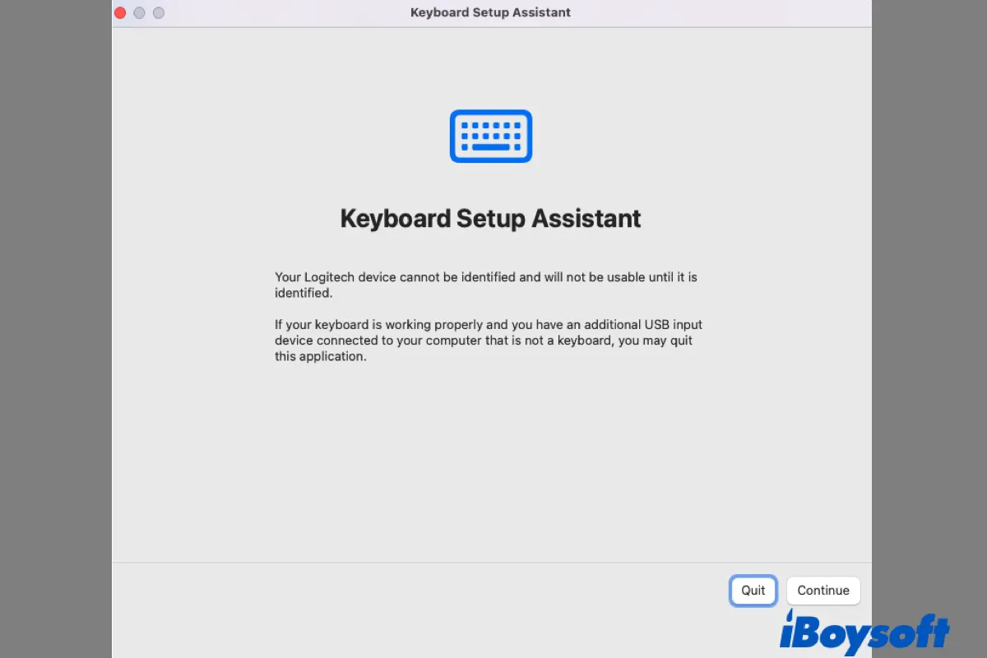
Uncommon Mac W

Slide 19
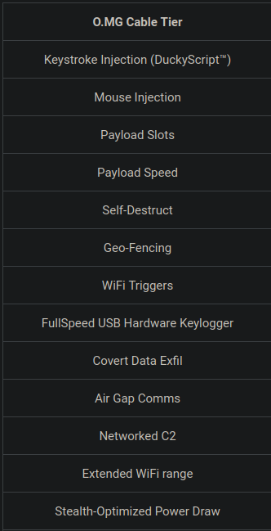
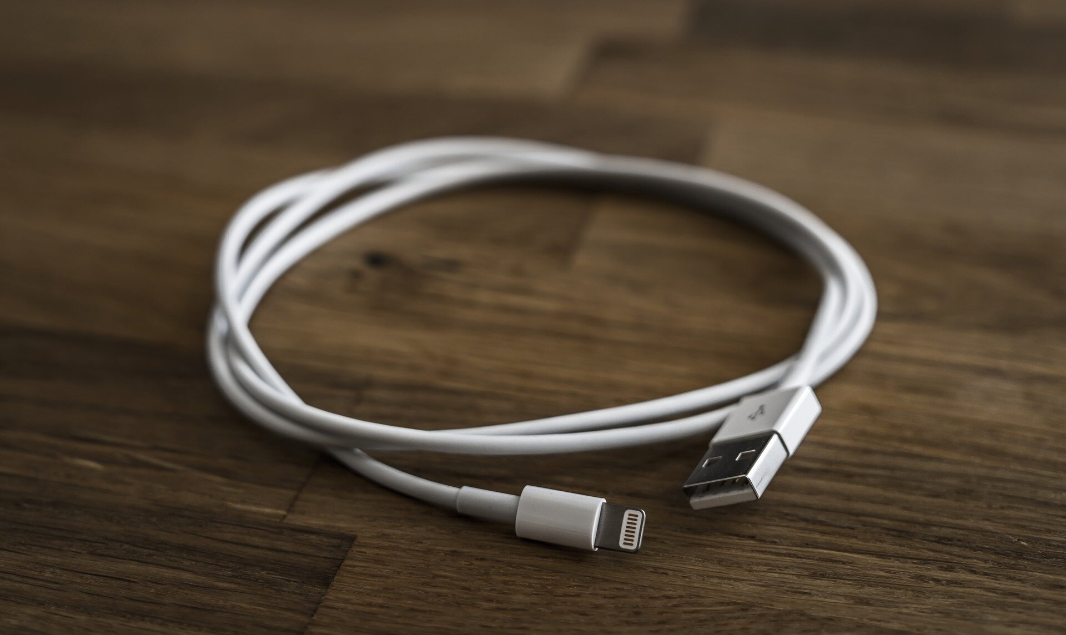
Malicious Lighting Cable

Slide 20
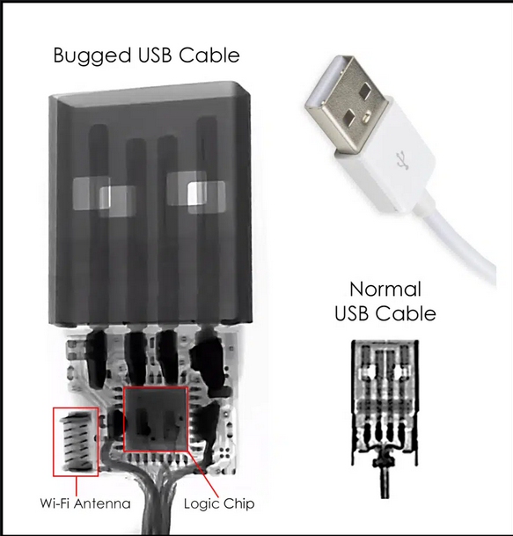
Malicious USB Cable

Slide 21
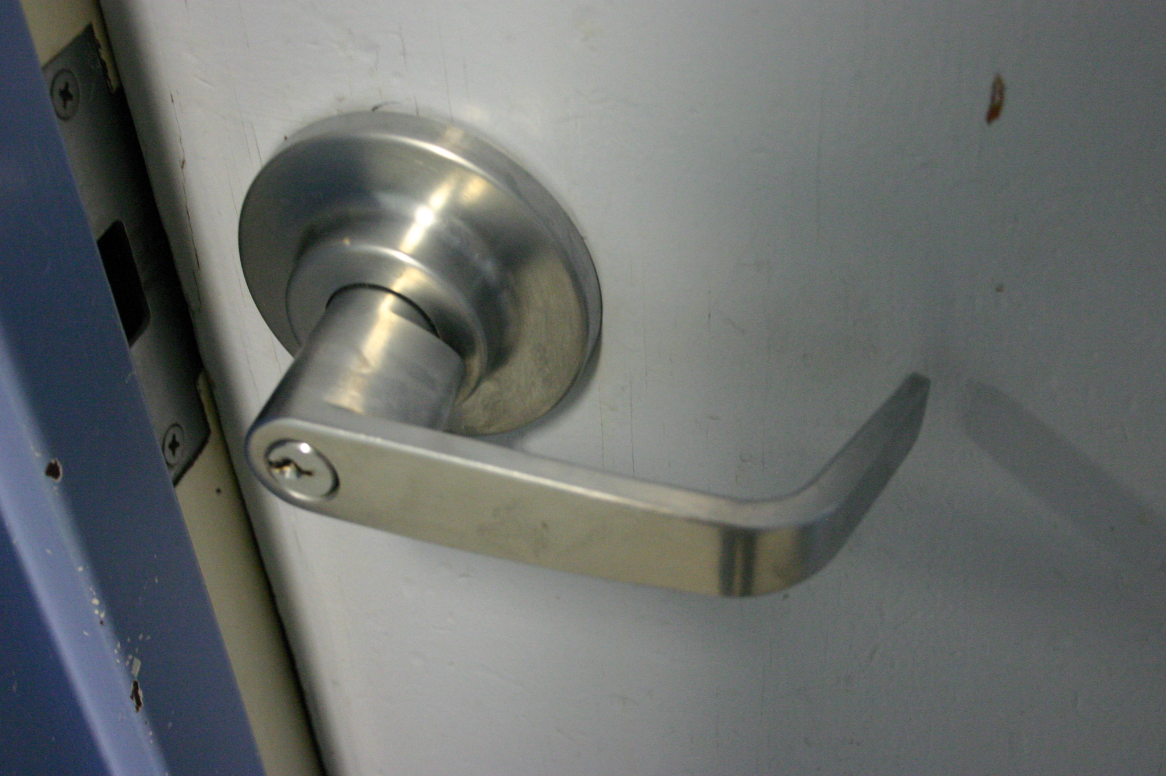
Under-Door Arm Tool
https://www.youtube.com/watch?v=9NYr_v1xAGQ&ab_channel=DeviantOllam

Slide 22
Social Engineering
Most physical security heavily involves social engineering
Physical entry skills can only take you so far!
People are often the weak link
https://www.youtube.com/watch?v=Pd7x2bHVSAs&ab_channel=KaliLinuxHacker
https://www.youtube.com/watch?v=lc7scxvKQOo&ab_channel=oraclemind

